Slide 1


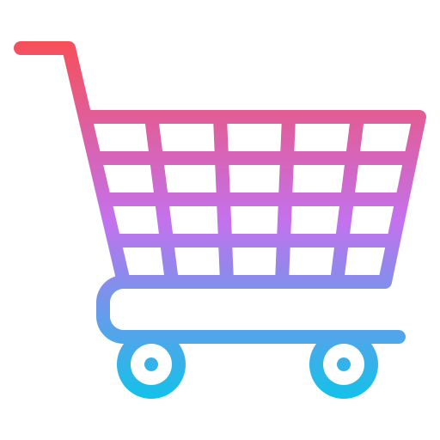
CART
SHARING

Slide 2

Problem STAtement
Enable cart sharing and device upgrade in the mobile app.
The primary account holder shares their cart with other account holders.
Cart can be shared via a sharable link or NFC
All users in the shared cart can view updates in real-time and collaborate on finalizing the cart products.
Once all users agree on the items, the primary account holder places a single order for all products.

Slide 3


WHY WE CHOSE THIS???
Unique and Innovative: This solution fills a gap in the market with a fresh approach to cart sharing and group ordering.
Challenge and Growth: We’re excited to tackle a complex problem that pushes our creativity and technical skills.
Team Enthusiasm: Developing something original fuels our passion and motivates us to deliver an exceptional user experience.
Real-World Impact: By addressing this issue, we can foster collaboration in shopping, making the experience more impactful for users, while continuously iterating based on feedback.

Slide 4
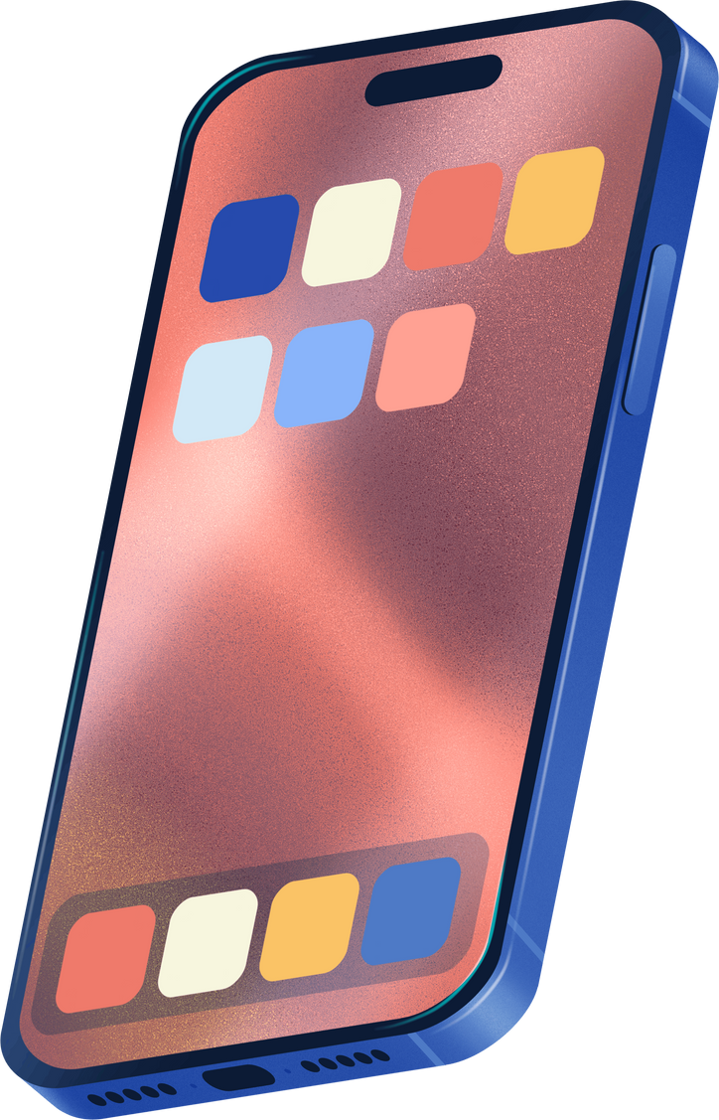


Challenges Faced
Team Formation: We started as a team of five girls who were strangers, but through effective collaboration and communication, we overcame initial hurdles and developed strong teamwork.
We had never worked on a problem statement involving group ordering or real-time technology, which required us to learn new concepts and skills quickly, fostering our growth as a team.

Slide 5

About technology
• Front-end: Angular for responsive, dynamic UI.
• Back-end: Spring Boot for scalable, secure API development.
Caching: Redis for enhanced performance and real-time data management.
Database: MySQL for reliable, structured data storage.
Real-time Functionality: Firebase for real-time notifications and user authentication.

Slide 6


SOLUTION
We are offering users the ability to add items to their cart without the need to log in, promoting a seamless shopping experience. Multiple users can access shared carts, but the primary account holder manages the payment and shipping processes. Importantly, users are not required to upgrade their plans, as all functionalities operate through a simple sharable link. Additionally, all data within the link is visible in real time, allowing for efficient collaboration and updates among users.

Slide 7
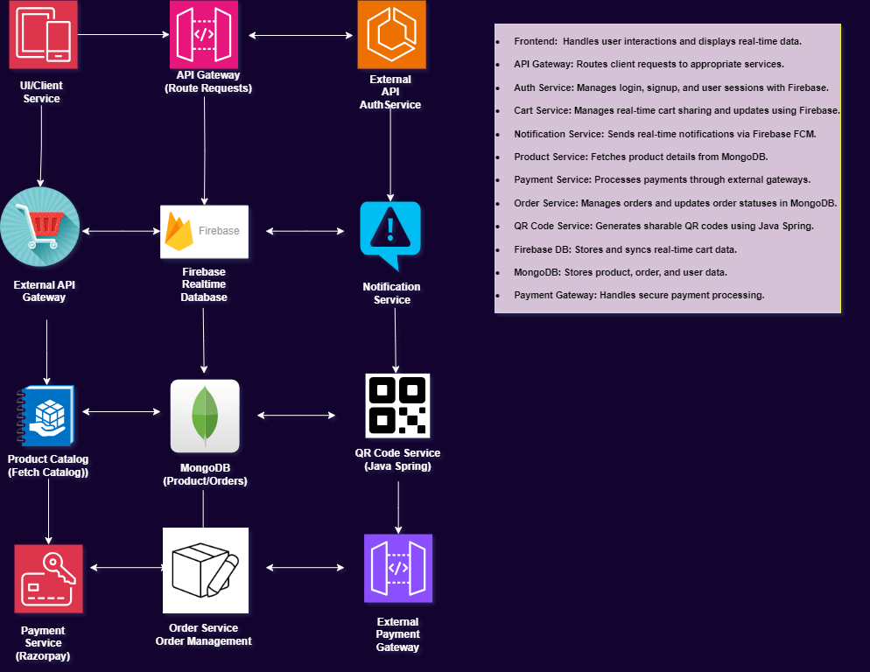
ARCHITECTURE

Slide 8

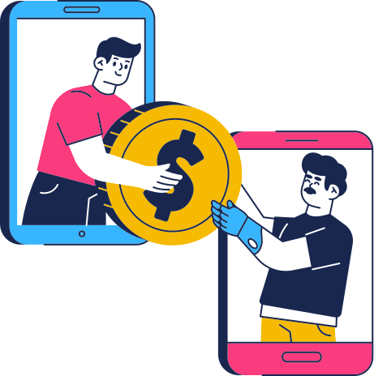

IMPACT
Convenient Shopping: Users can add items to the cart without logging in, enhancing accessibility.
Collaborative Purchases: Multiple users can engage in group shopping, fostering teamwork.
Real-Time Notifications: Immediate updates keep all users informed and engaged.
Simplified Payments: Centralized payment by the primary account holder streamlines the process.
Attractive Offering: No plan upgrades required, lowering barriers to user adoption.

Slide 9


Meet Our Team
Digital DIVAS
MUGDHA SHRIVASTAVA
ELISA RELHAN
SAKSHI GUPTA
Rakhi Sarova
Tanishtha Jawa

Slide 10


